Slide 1
MPEG4-AVC / H.264
Alexander Hermans
11 July 2012
Notes:
Hello everyone
My name
Today MPEG4-AVC stands for Advanced video coding. Also known as mpeg4-part10 or h.264
Standard created jointly bt MPEG and VCEG -> together JVT. Both groups have their names in their standards so that caused the dual name.

Slide 2
Topics
Introduction
Encoder/decoder pair
Main differences in MPEG4-AVC
Profiles and levels
Compression results
Patent issues
Summary
Notes:
Okay, a quick overview of what I want to talk about.
First I will give you a short introduction about the standard itself. How it was created and with which goals in mind it was created.
Then we will look at a encoder decoder pair. First for video encoding in general and then for MPEG4-AVC to show the differences
Then we will take some differences and look at them in detail. Each time showing how it was in previous standards and how it changed in 4-avc
Then we will look at some of the levels and profiles in MPEG4. The profiles define which tools are used during encoding and the levels specify which kind of performance an decoder is able to provide.
Then we will look at some compression results. Mainly objective but also some subjective results.
I will quickly talk about some patenting issues and finally a summary.

Slide 3
Introduction - History
1984: VCEG
1988: MPEG
1990: H.261
1993: MPEG1
1995: MPEG2 / H.262
1995: H.263
1999: MPEG4
1998: H.263v2
2003: MPEG4-AVC / H.264
2010: WebM
2013: MPEGH part2 / H.265
Notes:
In 1984 the Video Coding expert group, which were several groups of the ITU Telecommunication Standardization sector.
In 1988 the Moving Picture expert group was founded for video and audio compression.
In 1990 The VCEG created H.261. This was the first practical video coding standard. All later standards are very similar.
1993: MPEG1 by MPEG. Closely related to H.261 Targeting storage of digital video on CD with VHS quality
In 1995 Both MPEG and VCEG joined to create MPEG2 /H.262. Targeted at 3Mbit/s and above and support interlaced video. Done for analog TV broadcast who use interlaced video. Also for higher resolutions
But also 1995 VCEG did H.263 Created to improve on knowledge of MPEG1, MPEG2 and H.261 Mainly used for streaming media and mobile sector.
In 1998 H.263v2 This is compatible with MPEG4 Keeps everything from H.263 but improves encoding and robustness to data loss.
In 1999 MPEG did MPEG4 Also improvements from MPEG1 and MPEG2. Also targeted at streaming and mobile sector .
Then in 2003 MPEG and VCEG joined again to do MPEG4-AVC together they are called the joint video team (JVT) This is what I will talk about in this presentation. (Idea MPEG4-AVC doubles compression at same quality compared to MPEG4)
And a quick look into the future in 2013 MPEG H part 2 / H.265 should be finished. Will again double compression.
MANY OTHER VERSIONS!!!!

Slide 4



Introduction
MPEG4-AVC standard:
  Set of compression tools
  Profiles and levels
  Stream/File definition
  Decoder definition
Applications
  From low bitrate streaming
  …
  To storage on Blu-Ray Discs
   Depends on the profile.
Tools
Profile + level
+
Stream
Decoder
Notes:
So what is part of the AVC standard?
Well it is rather a set of compression tools. There are many smaller parts which can individually be used or not used depending on the application and its needs.
Because of that there is a set of different Profiles and levels. The profiles describe which techniques are used for the encoding and decoding. The levels specify the requirements regarding performance of the decoder. If a decoder is conform to a certain level if it is capable of decoding the data specified by that level.
As in many of these standards the standard only defines how a stream or file should look like and how the decoder will decode this. The encoder is not part of the standard and is only required to give out the right data format. The actual implementation can be decided by the developer.
There are many applications for MPEG4-AVC. They range from low bitrate streaming during a video call, to storage on Blu-Ray Discs in High definition. This completely depends on the chosen profile and level.

Slide 5



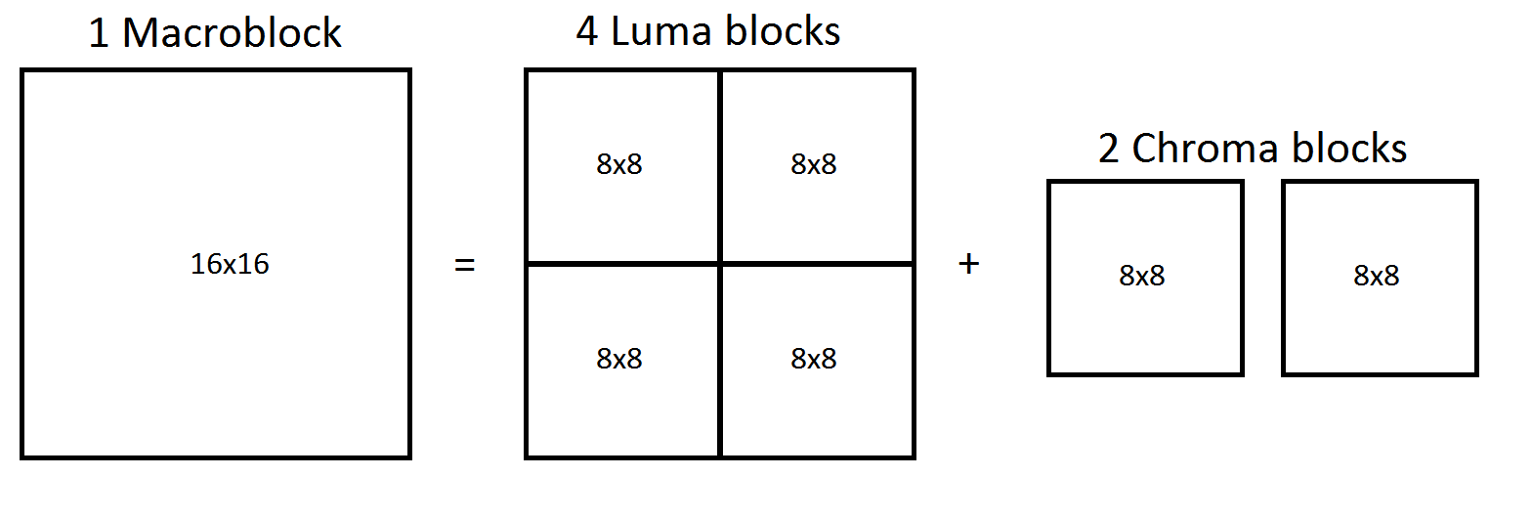
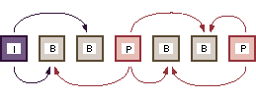

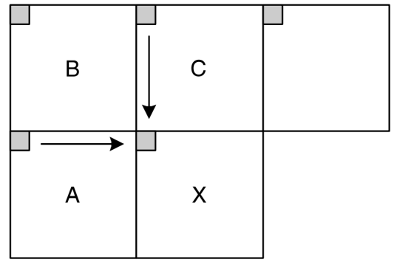
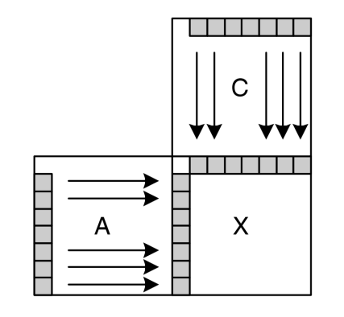
Encoder / Decoder pair
Encoder
I-frame?
No
Inter frame prediction
Inter frame prediction
Yes
No
Succes?
Encode
Encode
Motion vector,
encoding parameters,
reference frame…
Yes
8x8 DCT
Intra frame prediction
Intra frame prediction
Subtract prediction
Quantize
Dequantize, decode,
Add prediction
Lossless encoding
Store / Stream
Notes:
Now a quick recap, in order to understand where there are differences in the MPEG4-AVC encoders and decoders, we shall quickly take a look at how it is done in general for H.26x and MPEG.
First a general encoder.
We have a vido sequence. Here let’s take 1 image.
We disect the image into macro blocks, all of the same size. Usually 16x16 pixels and each is encoded on its own.
Now the question is if the frame is an I-frame. The means if it is an intracoded frame. If se we only do intra prediction. We have seen this already, you use the macroblocks to the left and to the rigth to predict the values, usually you can take something like a columnwise or rowwise prediction. This gives us a prediction for the image based on information within the frame.
Now if it is not an I-frame, we can also look at some other images and see if we can do Inter-frame prediction. For this we can look at other images and see if we find a place in the image which looks very much like this image and use this as a prediction.
If we fail to do so, we will revert to intra frame prediction.
After that we subtract the prediction from the original pixel values and then encode the residual values. This is usually done using a 8x8 DCT.
The results are then quantized and this data is then encoded using some lossless encoding algorithm.
This macroblock is then ready to be stored or streamed.

Slide 6
Decoder
Data
Decode
Dequantize
Intra frame prediction
Encoding?
Inverse DCT
Inter
Inter frame prediction
Add prediction
Yes
I/P frame?
Combine to Macro block
No
Notes:
For the decoder it is just the other way around.
We take the data, then decode it, here it goes into two directions.
The data from the quantization is dequantized, then the inverse DCT is applied, to get the residual back.
The other parameters are used to decide if this block was intra or inter frame coded. We do the same coding and add the prediction to the residual.
Now we combine multiple blocks to a macroblock. If this MB is part of an I or a P frame we add it to the corresponding frame in the buffer. But in any case, we do also display it.

Slide 7
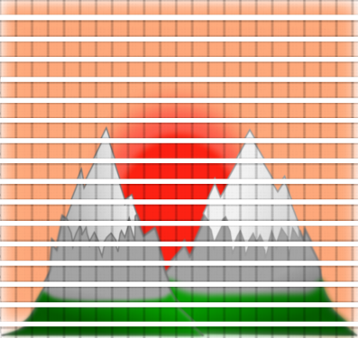
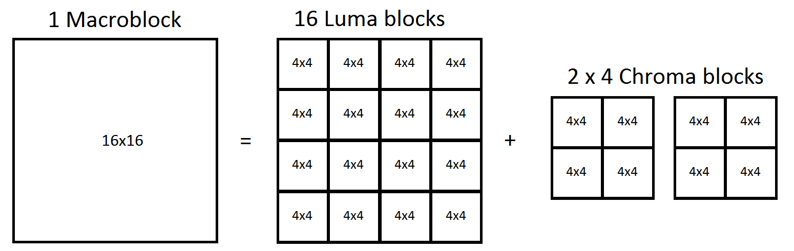
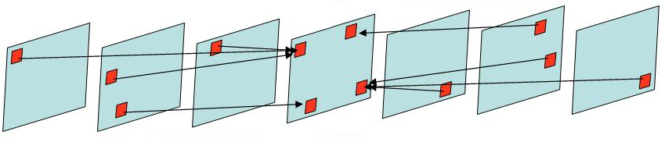
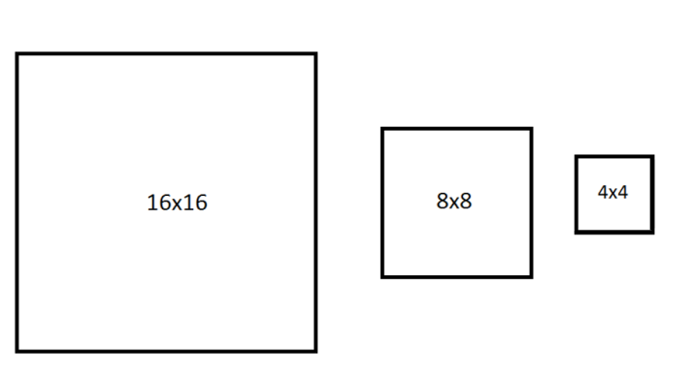
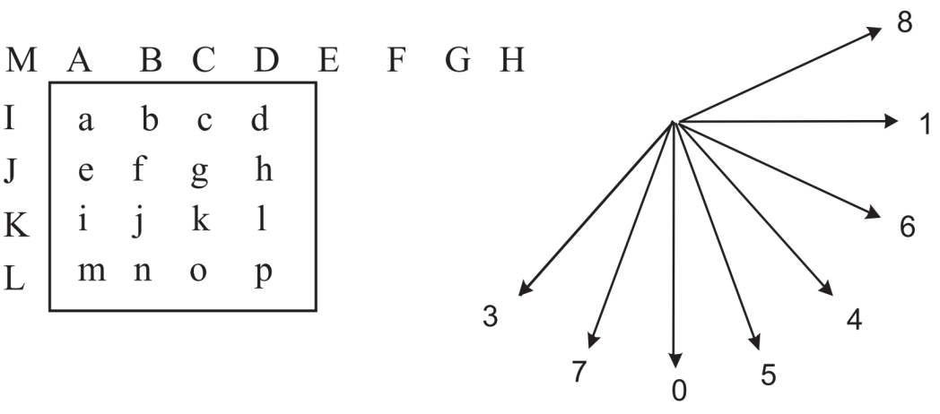
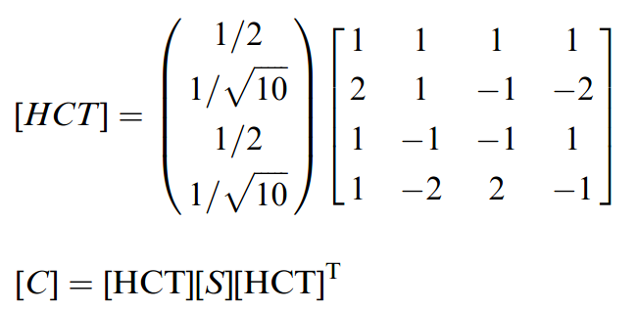
Encoder H.264
I-frame?
No
I-Slice?
Inter frame prediction
Inter frame prediction
Yes
Encode residual
No
Intra frame prediction
Encode
Succes?
High correlation transform
deblocking
filter
Motion vector,
encoding parameters,
reference frame…
Yes
Intra frame prediction
Subtract prediction
Quantize
Encode
Decode
Lossless encoding
Store / Stream
Notes:
Now a quick recap, in order to understand where there are differences in the MPEG4-AVC encoders and decoders, we shall quickly take a look at how it is done in general for H.26x and MPEG.
First a general encoder.
We have a vido sequence. Here let’s take 1 image.
We disect the image into macro blocks, all of the same size. Usually 16x16 pixels and each is encoded on its own.
Now the question is if the frame is an I-frame. The means if it is an intracoded frame. If se we only do intra prediction. We have seen this already, you use the macroblocks to the left and to the rigth to predict the values, usually you can take something like a columnwise or rowwise prediction. This gives us a prediction for the image based on information within the frame.
Now if it is not an I-frame, we can also look at some other images and see if we can do Inter-frame prediction. For this we can look at other images and see if we find a place in the image which looks very much like this image and use this as a prediction.
If we fail to do so, we will revert to intra frame prediction.
After that we subtract the prediction from the original pixel values and then encode the residual values. This is usually done using a 8x8 DCT.
The results are then quantized and this data is then encoded using some lossless encoding algorithm.
This macroblock is then ready to be stored or streamed.

Slide 8
Decoder
Data
Decode
Dequantize
Intra frame prediction
Residual
Encoding?
Intra
Inverse DCT
Inter
Inter frame prediction
Add prediction
Add prediction
Yes
I/P frame?
Combine to Macro block
Deblocking filter
No
Notes:
For the decoder it is just the other way around.
We take the data, then decode it, here it goes into two directions.
The data from the quantization is dequantized, then the inverse DCT is applied, to get the residual back.
The other parameters are used to decide if this block was intra or inter frame coded. We do the same coding and add the prediction to the residual.
Now we combine multiple blocks to a macroblock. If this MB is part of an I or a P frame we add it to the corresponding frame in the buffer. But in any case, we do also display it.

Slide 9
Main differences
Many changes, here only some of the interesting ones.
Can be divided into:
  Improved prediction
  Getting better prediction inter/intra-predictions.
  Improved coding
  Different transforms and better entropy encoding.
  Improved Robustness
  Error resilience during streaming.
  Other improvements
  Additional tools
Notes:
In MPEG4-AVC there are many differences which range from big changes like a inloop deblocking filter to small changes as one more prediction mode in inter-frame prediction.
The list is very long so in this presentation I will just cover some of the changes which I think are interesting or important.
In general the changes can be divided into 4 categories.
Improved prediction, which give a better prediction for each block such that the residual coding needs to code less information
Improved encoding. For example the integer transform which make it faster and gives more exact results. Or the different entropy encoders which compress in a better way.
Improved robustness, which makes the data more resilient to errors. This is mainly interesting for streaming.
Other improvements, such as a packetization standard which makes it easier to send files over a network or special flags for interlaced videos. This will not be covered here.
In the next several slides I will go into detail a bit about the changes I already mentioned in the encoder outline. I will try to quickly explain how it was before in earlier standards and how it is now.

Slide 10


Intra prediction – MPEG4
DC:
AC:

Slide 11
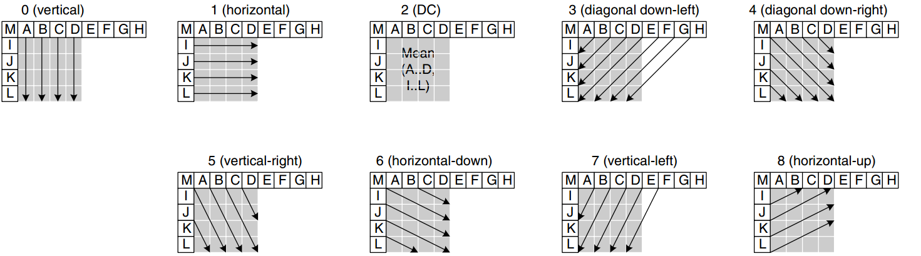
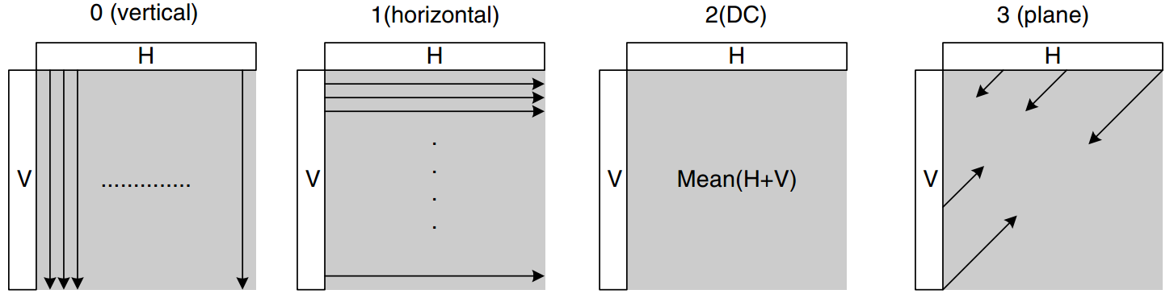
Intra prediction – MPEG4-AVC
4x4 blocks:
16x16 luma blocks, 8x8 chroma blocks:

Slide 12
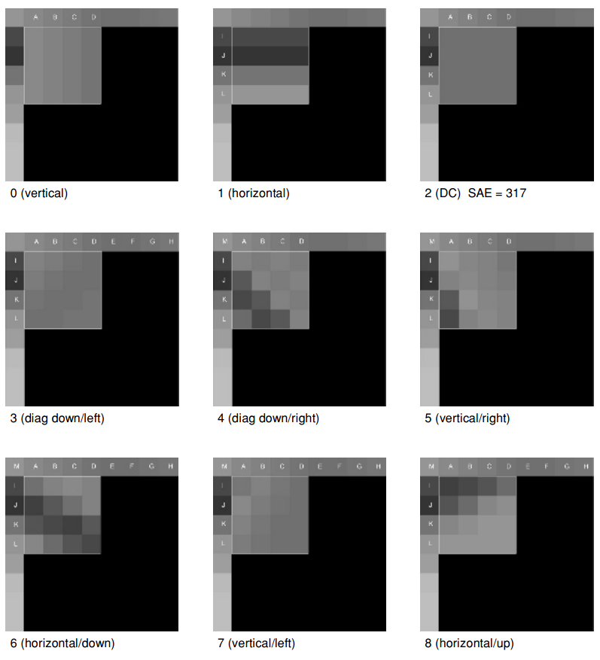

Intra prediction – MPEG4-AVC
16x16 blocks:
4x4 blocks:

Slide 13
Inter prediction
I
P
B
4x4 = 16 blocks
B-frame:
16x2 = 32 reference frames.
P-frame:
16x1 = 16
reference frames.
Mean of both references

Slide 14
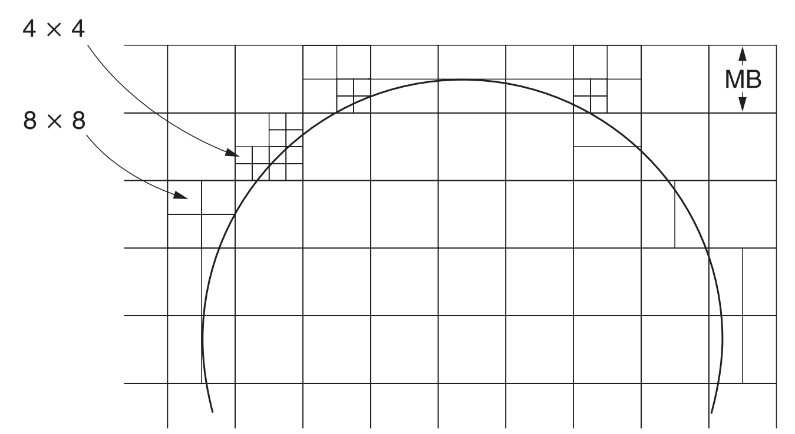
Inter prediction
4x4 | 4x4
4x4 | 4x4
16x16
8x8 | 8x8
8x8 | 8x8
16x8
16x8
8x16 | 8x16
4x8 | 4x8
8x4
8x4

Slide 15
Inter prediction
Weighted prediction
  Block = w₁∙ prediction₁ + w₂∙ prediction₂
Prediction with offset
  Block = offset + prediction
Big compression gain when scenes are fading in or out.

Slide 16
Transform
Previous standards:
  8x8 Direct Cosine Transform (DCT)
MPEG4-AVC:
  4x4 Integer Transform
  Approximates a 4x4 DCT
  Can be implemented without divisions
  Only 16 bit operations required.
Notes:
Done because smaller makes it easier to adapt to local changes, but also because it reduces implementation complexity

Slide 17
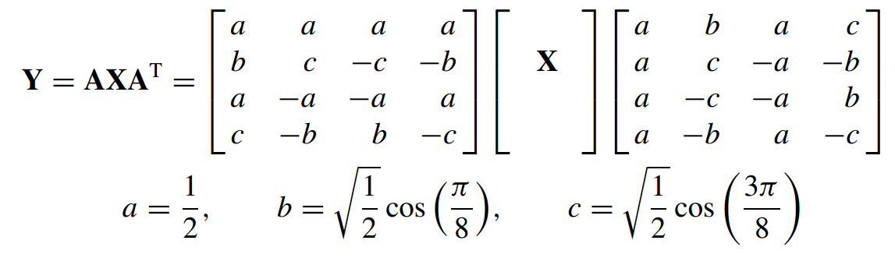
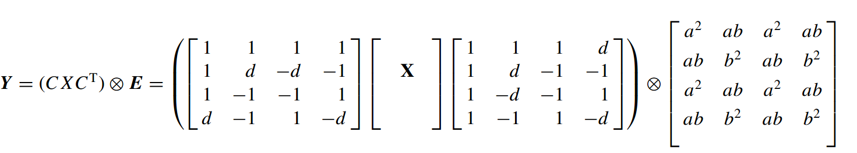
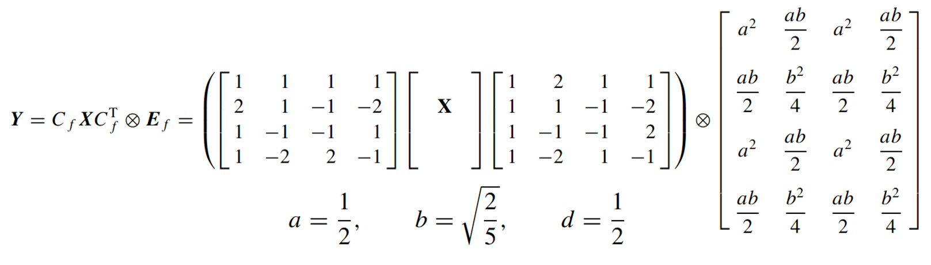
Transform
Include in
quantization
Notes:
D = b/c

Slide 18
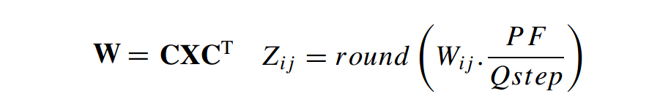
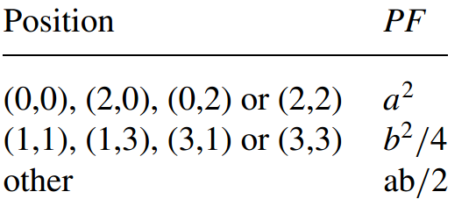
Quantization
8x8 DCT uses a quantization matrix
MPEG4-AVC uses a scaling factor.
  Needs to include the pre-scaling matrix
  No divisions allowed.
Notes:
Every 6 QP, Qstep doubles. Goes up to 51.

Slide 19
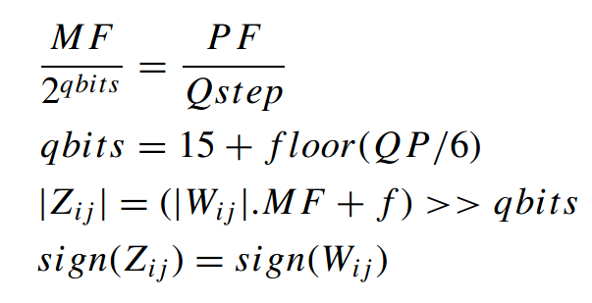

Slide 20
Entropy encoding
CAVLC: Context-based Adaptive Variable Length Coding
  Compactly represents sequences of zeros.
  Uses 1 out of 5 Tables based on:
    Number of zeros
    Max. number of trailing non-zeros.
    8, 3, 4, 0, 0, 0, 1, 2, 0, 0, 0, 0, 0, 1
CABAC: Context-based Adaptive Binary Arithmetic Coding
  Works only on binary data.
  Based on context, picks one of about 400 context models.
  Arithmetic encoding
Notes:
CABAC is better, but more complex.x

Slide 21
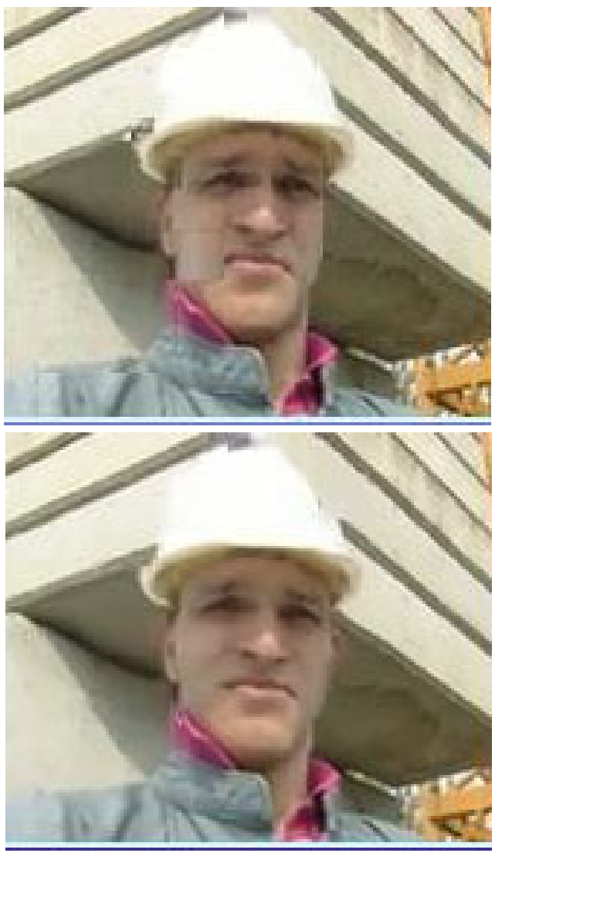
Inloop deblocking filter
In MPEG4:
  Postprocessing is suggested,
  but not mandatory.
In MPEG4 – AVC:
  Inloop deblocking filter is mandatory.
  Done for the edge of every 4x4 block.
Advantages:
  Integration guarantees usage.
  No extra frame buffer needed.
  Generally gives better results.
Notes:
Not new as post processing was already in mpeg4, but better now.
Better quality -> allows for lower bitrate encoding

Slide 22
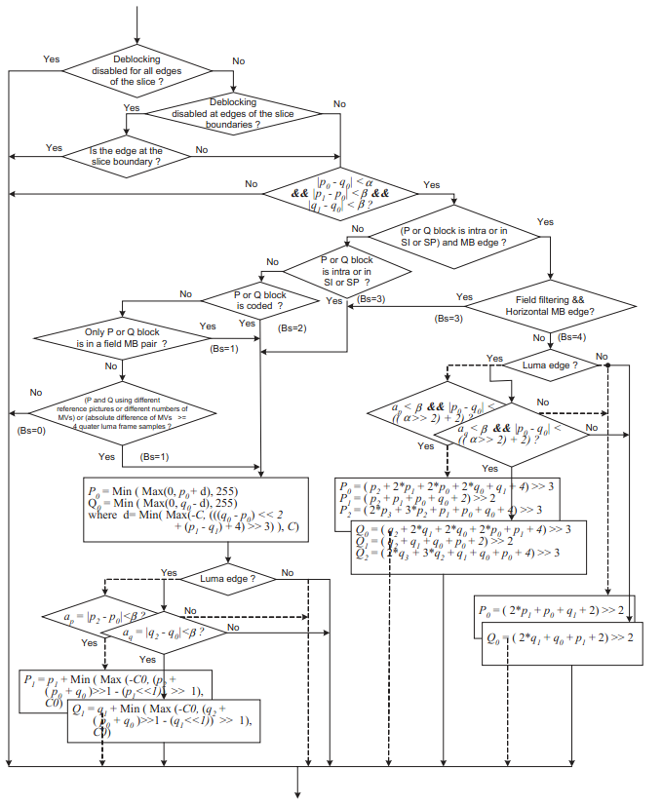
Inloop deblocking filter
Filter strength based on:
  Encoding type
  Deblocking parameter
  Interlaced video
  Block content
Can change every pixel.

Slide 23
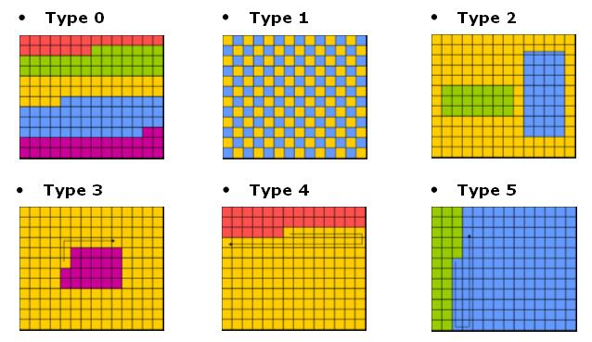
Data ordering
Arbitrary slice ordering (ASO)
  Previously slices had a fixed ordering.
  Now slices can be decoded in any order.
  Improves decoding delay when streaming.
Flexible macroblock ordering (FMO)
  Previously a fixed scanning
  order to create slices.
  FMO allows for new orders.

Slide 24
Other differences
Secondary transform functions
Skipped blocks with motion
Quarter pixel accurate motion prediction mandatory
More flexible way of handling interlaced video
And many more…
Notes:
After the transform, DC values of 16x16 intra blocks can be encode

Slide 25
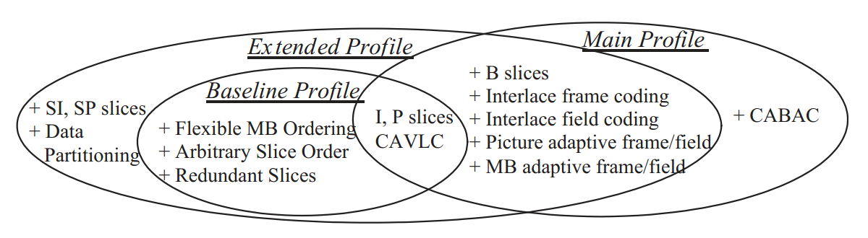
Profiles and levels
Currently there are 21 Profiles
  Specify which ‘tools’ the decoder supports.
Baseline Profile:
  Low-cost
  Data-robustness
  Intended for Video conferencing

Slide 26
Profiles and levels
Extended profile
  Extra robustness
  Supports server stream switching
  Intended for streaming
Main profile
  High compression
  Used for digital TV broadcast (not HD)
Other profiles
  High Profile(s) (HDTV , Blu-Ray)
  Scalable Profile
  Stereo Profile
Notes:
What is the scalable profile

Slide 27
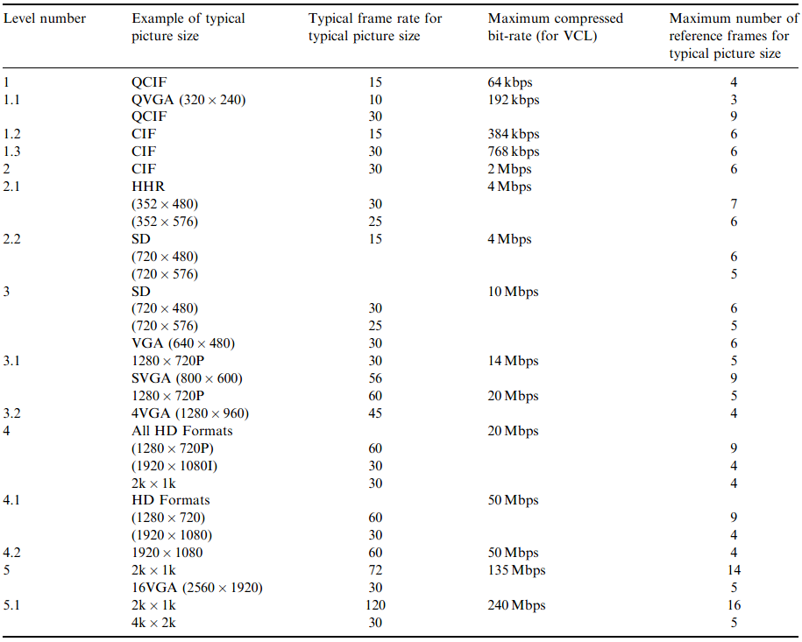
Profiles and levels

Slide 28
Compression results
Tested using:
  1.61GB raw video file. 1280x720, 52 seconds, no sound.
  http://media.xiph.org/
  Dual core 2.0 GHz, 2GB Ram, Win7, limited to 1 core.
Compressed at different bitrates and using different standards.

Slide 29
Compression results
bitrate | MPEG1 | MPEG4 | MPEG4 AVC | WebM | Expected
96kbps | 5.976KB 1m7 | 4.799KB 1m11 | 623KB 1m27 | 1.265KB 1m43 | 624KB
192kbps | 5.986KB 1m7 | 4.810KB 1m7 | 1.159KB 1m40 | 1.528KB 1m49 | 1.248KB
320kbps | 6.004KB 1m7 | 4.830KB 1m13 | 1.844KB 1m51 | 2.163KB 1m54 | 2.080KB
512kbps | 6.044KB 1m7 | 4.882KB 1m13 | 2.850KB 2m5 | 3.129KB 2m | 3.328KB
1000kbps | 6.498KB 1m7 | 6.336KB 1m24 | 5.383KB 2m30 | 5.681KB 2m8 | 6.500KB
2000kbps | 12.054KB 1m8 | 11.902KB 1m12 | 10.469KB 3m3 | 10.738KB 2m17 | 13.000KB
4000kbps | 21.548KB 1m8 | 25.465KB 1m8 | 20.576KB 3m45 | 21.069KB 2m23 | 26.000KB
8000kbps | 29.706KB 1m9 | 25.465KB 1m8 | 41.224KB 4m30 | 28.107KB 2m28 | 52.000KB
auto | 27.922KB 1m12 | 25.465KB1m13 | 17.128KB 3m36 | 26.346KB 2m23 | -
bitrate | MPEG1 | MPEG4 | MPEG4 AVC | WebM | Expected
96kbps | 5.976KB 1m7 | 4.799KB 1m11 | 623KB 1m27 | 1.265KB 1m43 | 624KB
192kbps | 5.986KB 1m7 | 4.810KB 1m7 | 1.159KB 1m40 | 1.528KB 1m49 | 1.248KB
320kbps | 6.004KB 1m7 | 4.830KB 1m13 | 1.844KB 1m51 | 2.163KB 1m54 | 2.080KB
512kbps | 6.044KB 1m7 | 4.882KB 1m13 | 2.850KB 2m5 | 3.129KB 2m | 3.328KB
1000kbps | 6.498KB 1m7 | 6.336KB 1m24 | 5.383KB 2m30 | 5.681KB 2m8 | 6.500KB
2000kbps | 12.054KB 1m8 | 11.902KB 1m12 | 10.469KB 3m3 | 10.738KB 2m17 | 13.000KB
4000kbps | 21.548KB 1m8 | 25.465KB 1m8 | 20.576KB 3m45 | 21.069KB 2m23 | 26.000KB
8000kbps | 29.706KB 1m9 | 25.465KB 1m8 | 41.224KB 4m30 | 28.107KB 2m28 | 52.000KB
auto | 27.922KB 1m12 | 25.465KB1m13 | 17.128KB 3m36 | 26.346KB 2m23 | -
bitrate | MPEG1 | MPEG4 | MPEG4 AVC | WebM | Expected
96kbps | 5.976KB 1m7 | 4.799KB 1m11 | 623KB 1m27 | 1.265KB 1m43 | 624KB
192kbps | 5.986KB 1m7 | 4.810KB 1m7 | 1.159KB 1m40 | 1.528KB 1m49 | 1.248KB
320kbps | 6.004KB 1m7 | 4.830KB 1m13 | 1.844KB 1m51 | 2.163KB 1m54 | 2.080KB
512kbps | 6.044KB 1m7 | 4.882KB 1m13 | 2.850KB 2m5 | 3.129KB 2m | 3.328KB
1000kbps | 6.498KB 1m7 | 6.336KB 1m24 | 5.383KB 2m30 | 5.681KB 2m8 | 6.500KB
2000kbps | 12.054KB 1m8 | 11.902KB 1m12 | 10.469KB 3m3 | 10.738KB 2m17 | 13.000KB
4000kbps | 21.548KB 1m8 | 25.465KB 1m8 | 20.576KB 3m45 | 21.069KB 2m23 | 26.000KB
8000kbps | 29.706KB 1m9 | 25.465KB 1m8 | 41.224KB 4m30 | 28.107KB 2m28 | 52.000KB
auto | 27.922KB 1m12 | 25.465KB1m13 | 17.128KB 3m36 | 26.346KB 2m23 | -
bitrate | MPEG1 | MPEG4 | MPEG4 AVC | WebM | Expected
96kbps | 5.976KB 1m7 | 4.799KB 1m11 | 623KB 1m27 | 1.265KB 1m43 | 624KB
192kbps | 5.986KB 1m7 | 4.810KB 1m7 | 1.159KB 1m40 | 1.528KB 1m49 | 1.248KB
320kbps | 6.004KB 1m7 | 4.830KB 1m13 | 1.844KB 1m51 | 2.163KB 1m54 | 2.080KB
512kbps | 6.044KB 1m7 | 4.882KB 1m13 | 2.850KB 2m5 | 3.129KB 2m | 3.328KB
1000kbps | 6.498KB 1m7 | 6.336KB 1m24 | 5.383KB 2m30 | 5.681KB 2m8 | 6.500KB
2000kbps | 12.054KB 1m8 | 11.902KB 1m12 | 10.469KB 3m3 | 10.738KB 2m17 | 13.000KB
4000kbps | 21.548KB 1m8 | 25.465KB 1m8 | 20.576KB 3m45 | 21.069KB 2m23 | 26.000KB
8000kbps | 29.706KB 1m9 | 25.465KB 1m8 | 41.224KB 4m30 | 28.107KB 2m28 | 52.000KB
auto | 27.922KB 1m12 | 25.465KB1m13 | 17.128KB 3m36 | 26.346KB 2m23
Zip: 254.862KB
5m51

Slide 30
Compression results - playback
Playback using VLC player, limited to 1 core.
bitrate | MPEG1 | MPEG4 | MPEG4 AVC | WebM
96kbps | 9% 59MB | 9% 62MB | 15% 68MB | 14% 54MB
8000kbps | 13% 60MB | 13% 63MB | 36% 73MB | 23% 58MB

Slide 31

Compression results – 96kbps
MPEG1 5.976KB | MPEG4 4.799KB
MPEG4 – AVC 623KB

Slide 32
Compression results
MPEG1 – 6.044KB
512kbps
MPEG4 – 6.335KB
1000kbps

Slide 33
Compression results
MPEG4 – 6.335KB
1000kbps
MPEG4 AVC – 5.383KB
1000kbps

Slide 34
Compression results
MPEG4 AVC – 5.383KB
1000kbps
WebM – 5.681KB
1000kbps
Notes:
AVC is a little better probably not visible
Can be skipped as not so extremely relevant!

Slide 35
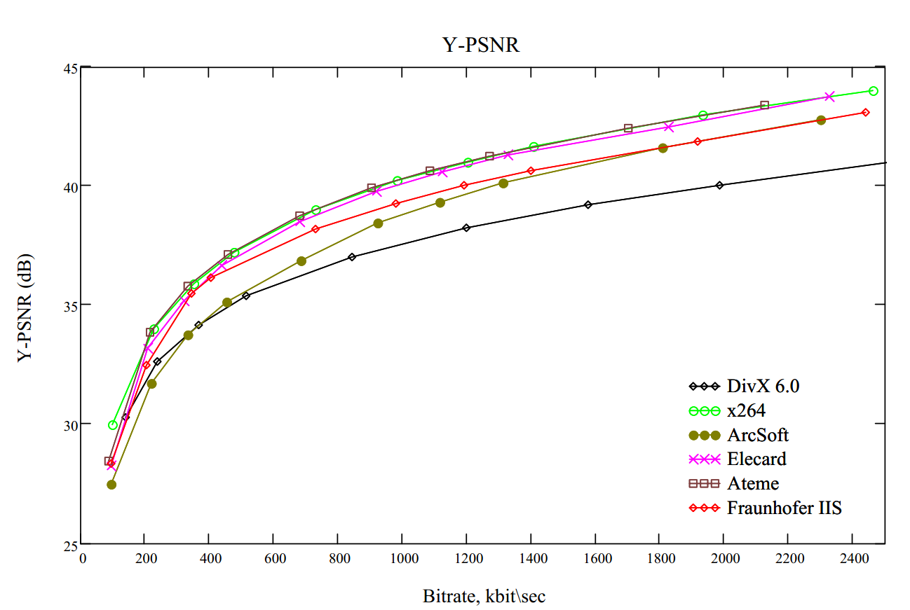
Compression results
Notes:
What is PSNR ?

Slide 36
Patenting in MPEG4-AVC
MPEG4-AVC is covered with patented technology! (1700)
MPEG LA sells licenses. (No guarantees)
  First 100000 en/decoders are free, then 0.20$ / unit
  Videos shorter than 12 minutes free, then 0.02$ / copy
  Free for internet videos.
Developers of HTML5 are split into two sections.
  Chrome, Safari and IE support H.264 in HTML5
  Firefox and Opera does not.
Then come the audio licenses…
Notes:
AVC is covered with licensed technology. There are about 1700 which make out the most important patents in AVC. These are summarized in a 90 page document.
You can acquire a license to use these patents from an organization called MPEG LA. They are not affiliated with MPEG, neither do they hunt for people who use the technology without licenses. That is up to the actual owners of the patents. For example apple, samsung, microsoft and sony. This also means if someone holds another patent not in the pool yet, you can still be sued.
IF you distribute over 100000 de or encoders you have to pay 20 cents for each de or encoder.
If you distribute videos longer than 12 minutes you have to pay 2 cents for every copy, unless it is an internet video. These will be free forever as it was announced in 2010.
HTML5 is developed by the HTML 5 working group. It is split into supporters of H.264 and supporters of open formats like webm or ogg theora.
Chrome safarie and IE support h.264, while firefox and opera does not. Chrome also announced they were pulling support, but have not done so so far.
And so far we have ignored the audio. Often H.264 comes with AAC, which also uses patented technology!

Slide 37
Summary
The MPEG4-AVC standard specifies decoder and stream.
Improvement of compression by:
  Better predictions
  Better encoding of the data
Higher compression at cost of complexity.
Fine tune with profiles and levels.
You have to buy a license to use it on large scale.
Will be succeeded by MPEG-H Part 2 / H.265

Slide 38
Thank you for your
attention!
Questions?

